Slide 1
Qt Essentials
January 2018
Based on Qt 5.10
N.N.
N.N@company.com

Slide 2
Contents
Fundamentals | What Is Qt? Qt Modules Licensing Options Creating, Building, and Debugging Applications with Qt Creator Practical Tips for Developers
Qt Object Model | Qt's Object Model Object Communication Signals and Slots Event Handling
Meta-Object and Meta-Type Systems | Meta-Object System Property System Enumerations Variants Meta-Type System
Core Types | String Handling Item Containers Handling Files

Slide 3
Fundamentals

Slide 4
Contents
What Is Qt?
Qt Modules
Licensing Options
Creating, Building, and Debugging Applications with QtCreator
Practical Tips for Developers
Logging Messages, Asserts

Slide 5
Objectives
Learn…
...about the history of Qt
...about Qt's ecosystem
...a high-level overview of Qt
...how to create first hello world program
...build and run a program cross platform
...to use QtCreator IDE
...some practical tips for developing with Qt

Slide 6
The Qt Company: A Brief Introduction
Responsible for all Qt operations globally
Worldwide leader in
Qt API development
Qt Application Development
Design services – UI and UX
Trusted by over 5,000 customers worldwide
20+ years of Qt experience
250 in-house Qt experts
20% 2016 YoY growth
34M€ revenue in year 2017
http://www.qt.io

Slide 7
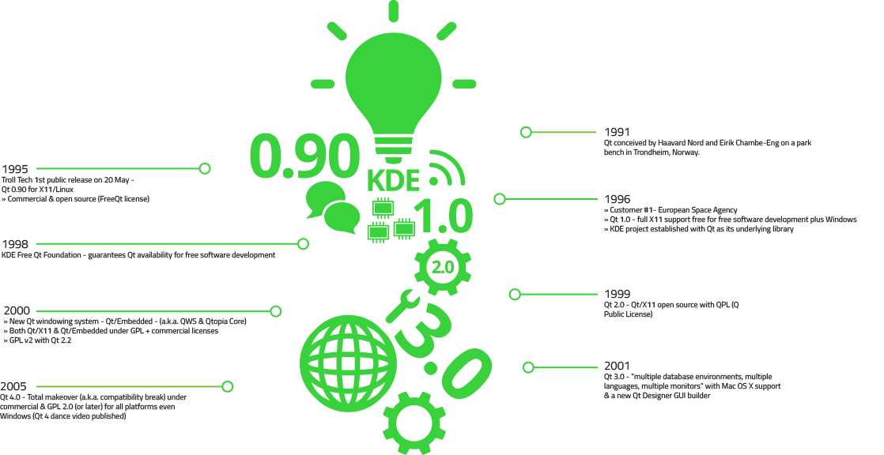
Qt History

Slide 8
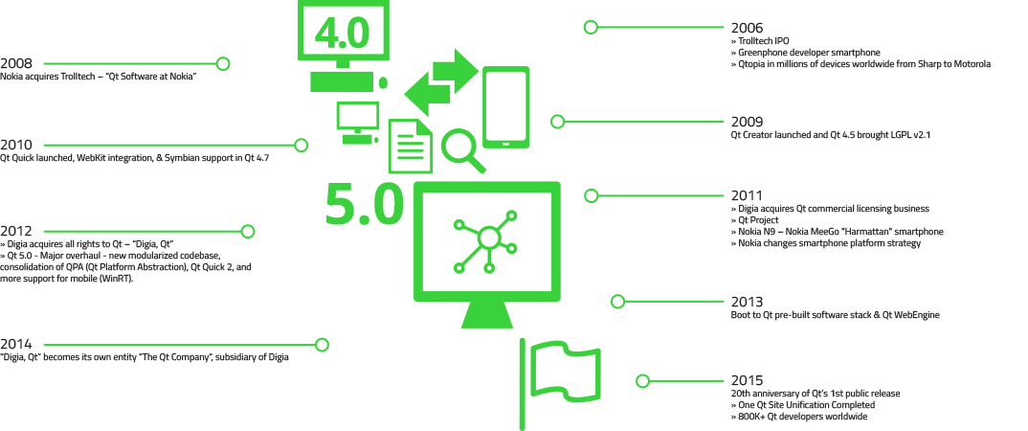
Qt History

Slide 9



What Is Qt?
All in One - Framework
Powerful & Modern Development Framework
Code Once, Deploy Everywhere
Cross-Platform
Integrated Development Tools
Productive development environment
Cross-Platform IDE, QtCreator

Slide 10










Qt for Application Development & use cases
Use cases
Qt Application Development
Desktop & Mobile Platforms:

Slide 11




Qt Device Creation & Qt offerings for industries
Vertical offering
Qt in Automation
Qt in Automotive
Qt in Medical
Qt in Digital TV
Qt Device Creation
Desktop & Mobile Platforms:

Slide 12
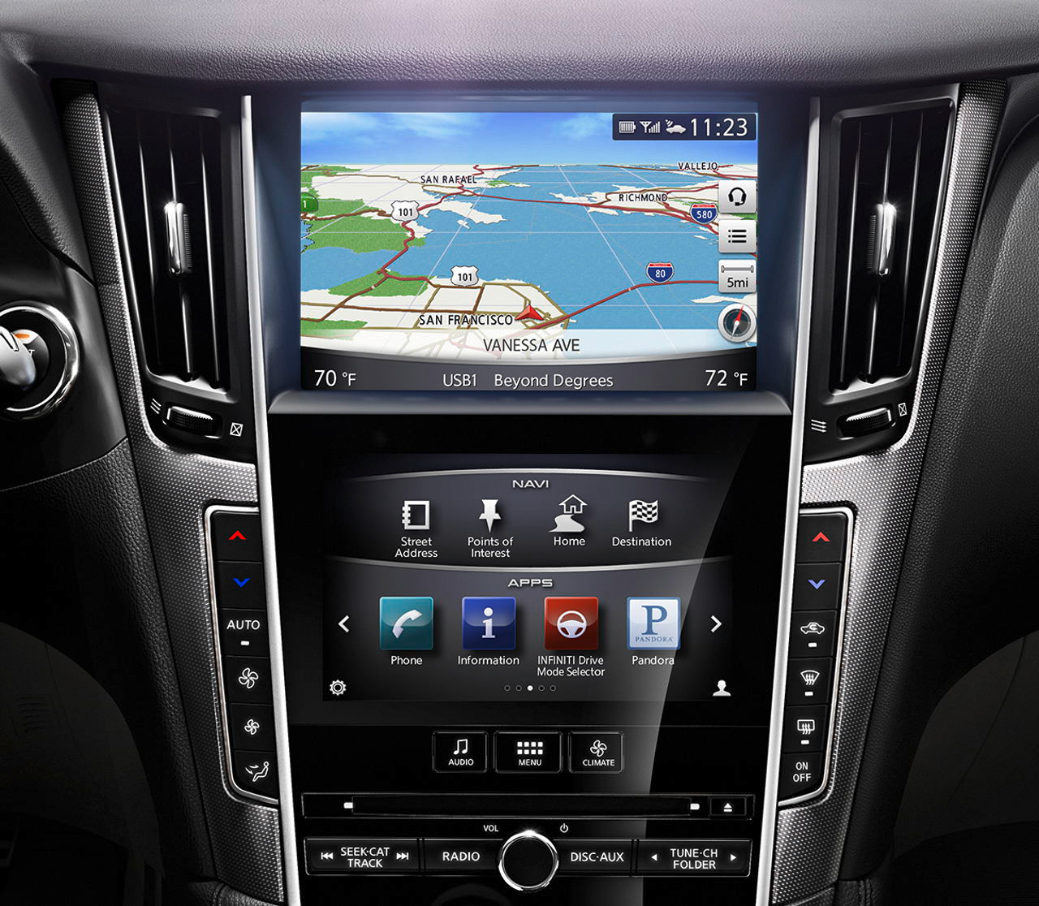
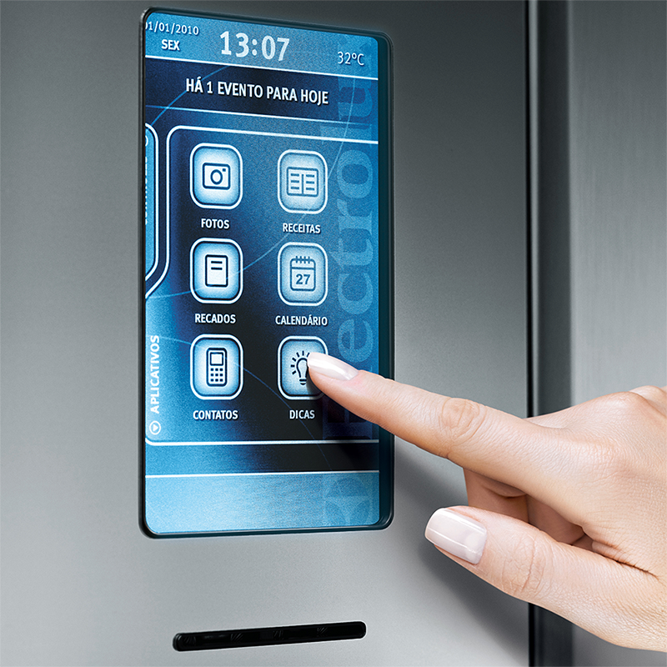
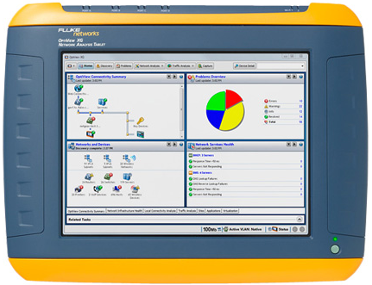
Where There’s a User Interface, There’s Qt
Automotive IVI
Refrigerators & Coffee Machines
Network Analyzers
Plus:
Medical Devices
Home Automation
Digital Photo Frames
Set Top Boxes
Industrial/UMPCS
and many, many more …

Slide 13



The Qt Company Trusted by 5000+ Companies from 70+ Industries
8
8 out of Top 10 Fortune 500 Companies Are Powered by Qt!

Slide 14
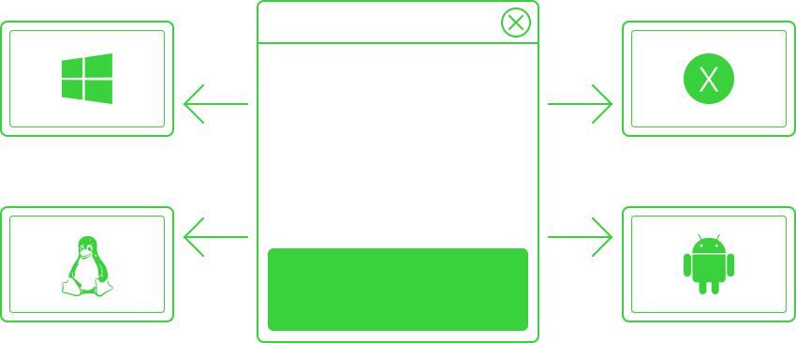
Qt Applications Are Native Applications
Qt / Windows
Windows GDI
Windows Kernel
PC HW
Qt / OSX
Cocoa
Mac Kernel
MacHW
Qt / Embedded
X11, Wayland, EGLFS
Linux Kernel
Embedded HW
Qt / Android
Android NDK
Android Kernel
Android HW

Slide 15
Qt Modules
Add-Ons
Canvas 3D
Charts
Qt Quick 2D renderer
Data Visualization
Purchasing
Active Qt
Graphical Effects
NFC
Location
Qt 3D
X11, Windows, Mac Extras
Print Support
Sensors
Concurrent
WebEngine
Android Extras
Image Formats
Positioning
Serial Port
WebSockets
XML & XML Patterns
SVG
Bluetooth
D-Bus
WebChannel
Essentials
Multimedia
Widgets
Quick Dialogs
Quick Controls
GUI
Widgets
Multimedia
Quick Layouts
Quick
Core
Network
SQL
Test
QML
QML

Slide 16
Licensing Options
Commercial
Support
Tools and Applications
GPL v3
Add-on modules available under commercial
license prior Qt 5.7
Qt Tools and Applications are available under GPL v3 and commercial license
Add-on Modules
LGPL v3
Qt Essentials and Add-ons are available under LGPL v3, GPL v2, and commercial license
Qt WebEngine has LGPL v2.1 requirement
Essentials modules
http://www.qt.io/licensing/

Slide 17
Licensing Options
Commercial license
No limitations of open source licenses
Silver-level support included
GPL v3
The original license, used in Qt
All proprietary code, IPR etc., will also have to be GPL licensed
No commercial possibilities without opening own source code
LGPL v3
Unlike LGPL v2, forbids creation of closed devices
Adds additional requirements making it less attractive in commercial usage
Mainly DRM restrictions, patent retaliation limitations, and Tivoization
LGPL v2.1
Used prior Qt 5.7
Allows dynamic linking to Qt libraries with any LGPL v2.1 compatible license
Still possible to use with Qt 5.6 LTS (Long Term Support) version

Slide 18

“Hello World” in Qt – Widget-Based
#include <QtWidgets>
int main(int argc, char *argv[])
{
QApplication app(argc, argv); // Loads the QPA plugin
QPushButton button("Hello world"); // Creates a widget
button.show();
return app.exec(); // Starts the event loop
}
Program consists of
main.cpp – application code
helloworld.pro – project file
ex-helloworld-widgets

Slide 19

“Hello World” in Qt – Qt Quick -Based
#include <QGuiApplication>
#include <QQmlApplicationEngine>
int main(int argc, char *argv[])
{
QGuiApplication app(argc, argv); QQmlApplicationEngine engine;
engine.load(QUrl(QStringLiteral("qrc:/main.qml")));
// Window created in QML return app.exec();
}
Program consists of
main.cpp – creation and startup of the QML engine
helloworld.pro – project file
qml.qrc – resource files, consisting main.qml
main.qml – application code
ex-helloworld-qtquick

Slide 20
Project File - helloworld.pro
helloworld.pro file • lists source and header files • provides project configuration
Assignment to variables
Possible operators =, +=, -=, *=
# File: helloworld.pro
greaterThan(QT_MAJOR_VERSION, 4): QT += widgets
TEMPLATE = app
SOURCES = main.cpp
Documentation: qmake Manual

Slide 21
Using qmake
qmake tool
Creates cross-platform make-files
Build project using qmake
Tip: qmake –project
Creates default project file based on directory content
Qt Creator IDE does it all for you
cd helloworld qmake helloworld.pro # creates target-dependent Makefile make # compiles and links application
./helloworld # executes application

Slide 22
Useful qmake Variables
Hint! Additional variables and values may be defined in the command line:
qmake “CONFIG += debug”
TEMPLATE - Defines the project type
app, vcapp
lib, vclib
subdirs
TARGET
Executable name (by default equals to the .pro file name)
QT
Modules, used in the project
Defined in tmkspecs/modules
QT += webkit sql network charts
CONFIG
Specifies a project configuration or compiler option
May refer to a project feature file (.prf) in mkspecs/features
E.g. a custom library with headers
INCLUDEPATH and DEPENDPATH
Sets the include search path (-I option)
RESOURCES
Specifies resource collection (.qrc) files to include in build
LIBS
Library path –L and library –l
Omit platform-dependent prefixes and extensions
DEFINES
Compiler pre-processor macors -D
INSTALLS
Files and folders to be copied after building (make install)
target.path += $$[QT_INSTALL_qml]/module
INSTALLS += target

Slide 23
Using qmake Variables
Scopes
win32:debug { SOURCES += paintwidget_win.cpp }
Single line conditional assignment
win32:DEFINES += QT_DLL
Environment variable reference
DESTDIR = $$PWD # Evaluated when the .pro file is processed
DESTDIR = $PWD # Evaluated when the Makefile is executed
Variable reference
TARGET = myproject_$${TEMPLATE}
qmake configuration options
You may ask the options with the command qmake –query
message(Qt version: $$[QT_VERSION])

Slide 24
Alternatives to qmake: cmake
Configuration file CMakeLists.txt
project(ex-cmake-project)
cmake_minimum_required(VERSION 2.8.11)
# Define sources
aux_source_directory(. SRC_LIST)
# Find headers
set(CMAKE_INCLUDE_CURRENT_DIR ON)
# Define Qt module locations
# Qt install folder defined with CMAKE_PREFIX_PATH
find_package(Qt5Widgets)
# Executable to be created
add_executable(${PROJECT_NAME} ${SRC_LIST})
# Link executable to any libraries
target_link_libraries(${PROJECT_NAME} Qt5::Widgets)
ex-cmake-project, documentation: cmake Manual

Slide 25
Alternatives to qmake: Qt Build Suite (QBS)
Declarative way to define the build graph
Syntax similar to QML
A project consists of one or more products
Modules define, how source code files are handled
QtGuiApplication { // Product subtype
targetName: "ex-qbs-project"
files: "main.cpp"
Depends { name: "cpp", "Qt.widgets" } // 2 modules
// Possible to define any rules, how files are handled
Group {
condition: qbs.targetOS.contains("linux")
fileTagsFilter: "application"
qbs.install: true
qbs.installDir: ".."
}
}
ex-qbs-project, documentation: Qbs Manual

Slide 26
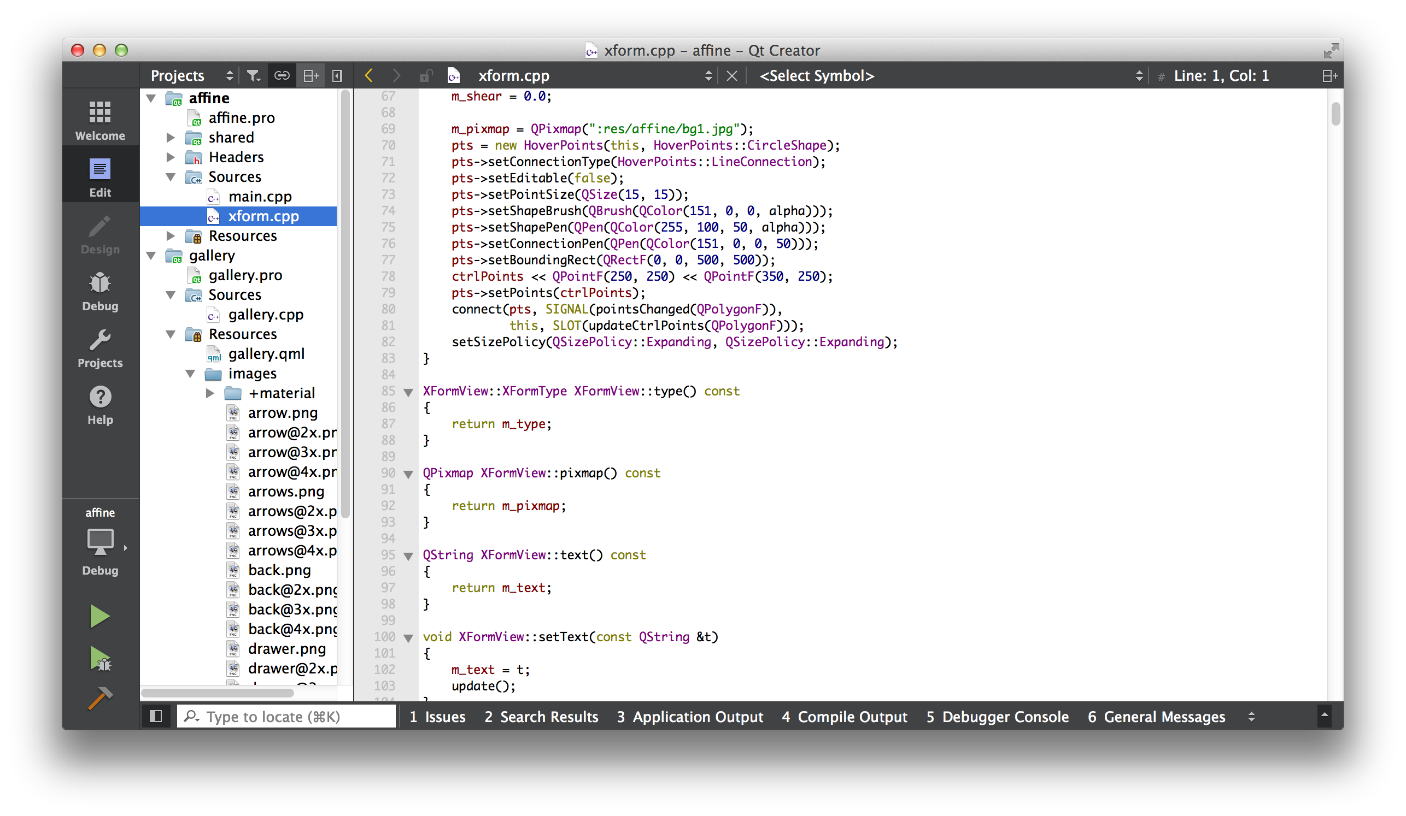
Creating, Building, and Debugging Applications with QtCreator
Advanced C++/QML code editor
Integrated GUI layout and forms designer for widgets and Qt Quick items
Project and build management tools – qmake, cmake, and qbs integrated
Integrated, context-sensitive help system
Visual C++, QML and JavaScript debugger
Rapid code navigation tools
Code analysis tools
QML profiler tool
Supports multiple platforms

Slide 27
Qt Creator IDE
Sidebar
Opened files
Symbol overview
Mode selector
Run
Debug
Build all
Quick Open
Output pane

Slide 28
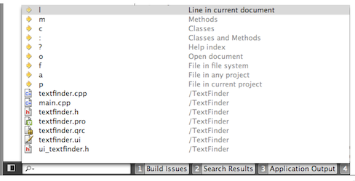
Finding Code – Locator
Click on Locator or press Ctrl+K (Mac OSX : Cmd+K)
Type in the file name
Press Return
Locator Prefixes
:<class name> - Go to a symbol definition
l<line number> - Go to a line in the current document
?<help topic> - Go to a help topic
o<open document> - Go to an opened document

Slide 29
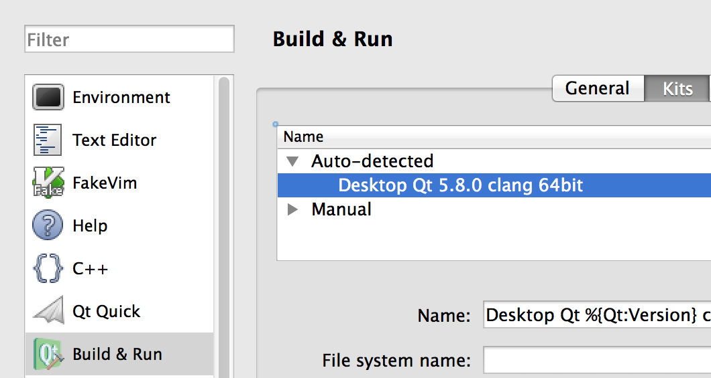
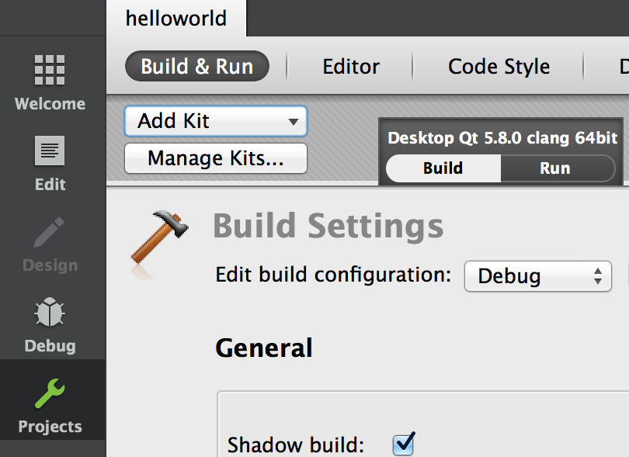
Kits
Build and run targets defined as kits
Tools > Options – Build & Run: Kits
A kit defines, which
Qt version is used (Qt versions sheet – qmake location)
compiler is used (Compilers sheet)
debugger is used (Debuggers sheet)
In Projects mode kits may be dynamically added/removed
Kit and build type selectable above run/debug buttons
Deployment and on-device debugging easy to configure
Tools > Options – Devices

Slide 30
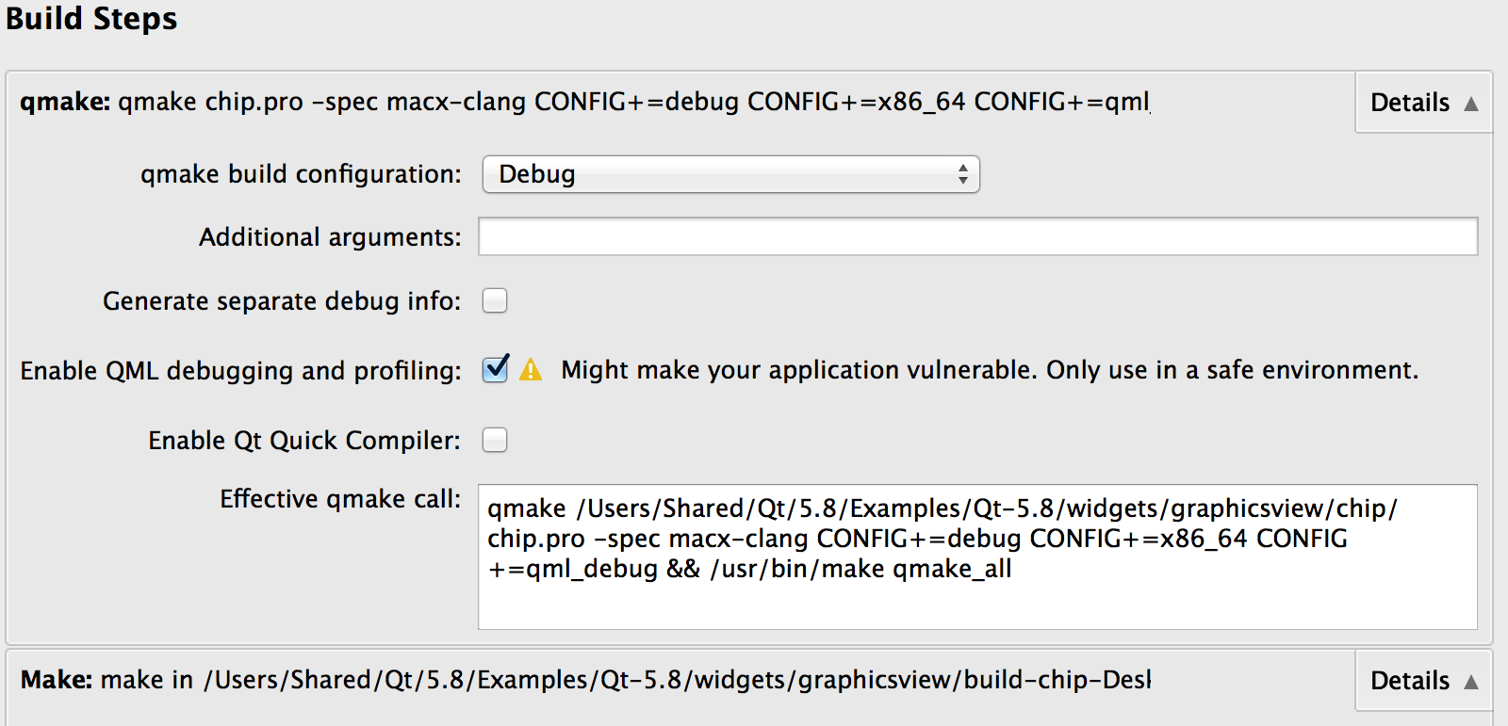
Build and Run Settings – Qt Creator Project Mode
Customize build steps
Add build steps
Add command line arguments
Add/edit environment variables

Slide 31
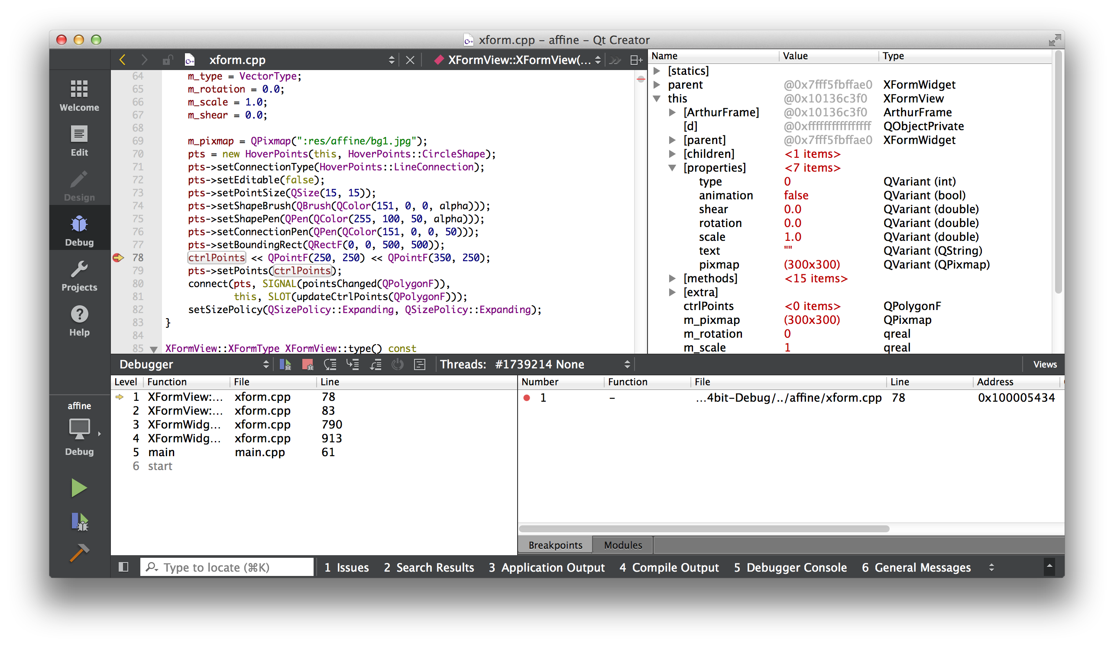
Debugging an Application – Locally or Remotely
Debug −> Start Debugging (o rF5)

Slide 32
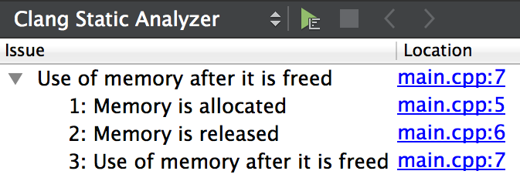
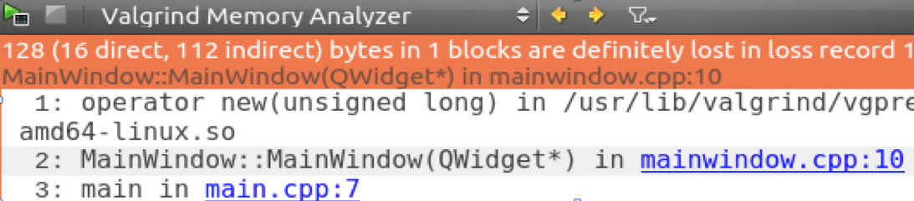
Code Analysis
C++ code analysis require a backend
QML analysis can be done with Qt tools
Clang static analyzer
Uses clang open source library as a backend
Detects more than a compiler (e.g. use of dangling pointers)
Valgrind memory analyzer and profiler
Detects, e.g., memory leaks and most frequently executed functions

Slide 33
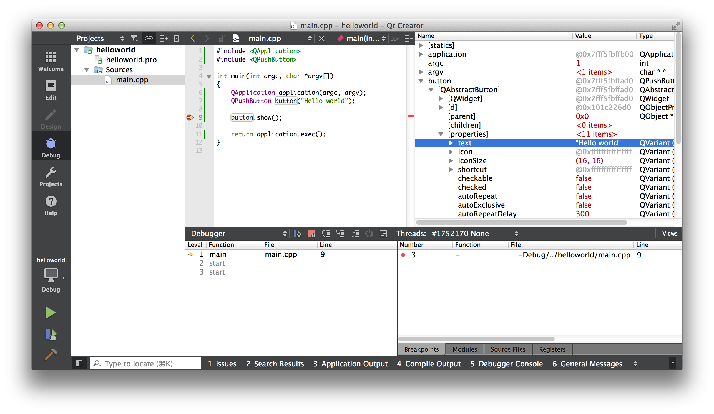
Qt Creator Demo "Hello World"
What we'll show:
Creation of an empty Qt project
Adding the main.cpp source file
Writing of the Qt Hello World Code
Showing Locator Features
Running the application
Debugging the application
Looking up the text property of our button

Slide 34
Practical Tips for Developers

Slide 35
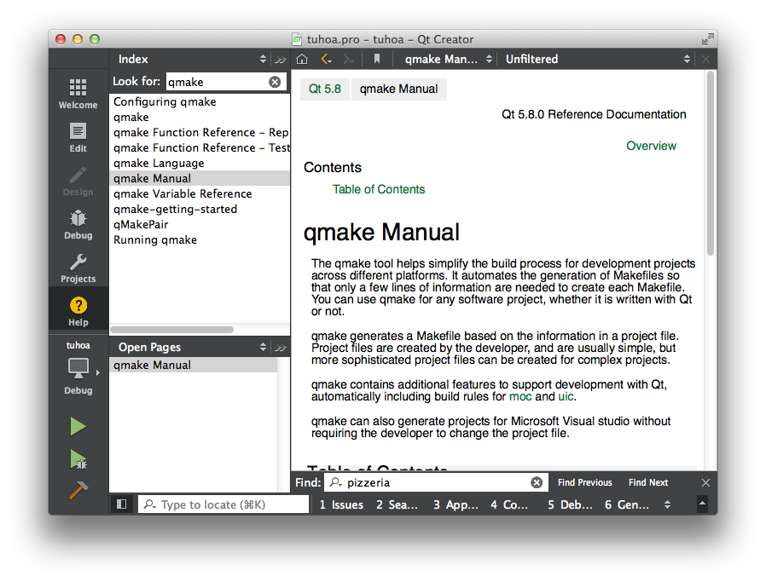
Qt Documentation
Reference Documentation
All classes documented
Contains tons of examples
Collection of Howto's and Overviews
A set of Tutorials for Learners

Slide 36
Finding the Answers
I need answers ASAP
Customers may use Qt support http://www.qt.io/support/
Meet Qt professional in IRC https://wiki.qt.io/Online_Communities
Questions and answers forum – Qt Centre http://www.qtcentre.org/content/
It does not work
Bug reporting and finding https://bugreports.qt.io/
Stack Overflow http://stackoverflow.com
I have some time to study Qt myself
Qt Developer Guides http://wiki.qt.io/Developer-Guides
Learning videos https://www.youtube.com/user/QtStudios
Books, tools, guides, documentation - http://wiki.qt.io/Main_Page
I want to know the latest Qt updates
Qt Blog http://blog.qt.io
I want to have some Qt apps for free
http://qt-apps.org
Qt's source code is easy to read, and can answer questions the reference manual cannot answer!

Slide 37
Qt Coding Convention
// Avoid acronyms, use camel-case
// Class names with capital first letter
// Function and variable names lower case first letter
#include <QObject>
class CustomObject : public QObject
{
Q_OBJECT
public:
explicit CustomObject(QObject *parent = 0);
void setString(const QString &string);
QString string() const;
protected:
bool event(QEvent *event) Q_DECL_OVERRIDE;
private:
QString m_string;
};
#include <QApplication>
#include <QLabel>
#include "customobject.h"
int main(int argc, char *argv[])
{
QApplication application(argc, argv);
QLabel label;
CustomObject customObject;
customObject.setString("Hello world");
label.setText(customObject.string());
label.show();
return application.exec();
}
#include "customobject.h"
CustomObject::CustomObject(QObject *parent) : QObject(parent) { }
void CustomObject::setString(const QString &string)
{
if (string != m_string) m_string = string;
} bool CustomObject::event(QEvent *event)
{
// Dummy example
return QObject::event(event);
}

Slide 38
Includes and Compilation Time
Class includes
#include <QLabel>
Module includes
#include <QtGui>
Reduce compilation time
Use class includes
#include <QLabel>
Forward declarations
QT_FORWARD_DECLARE_CLASS(QLabel)
Place module includes before other includes

Slide 39
Qt Debugging Aids – Logging
QDebug allows streaming debug information to QString or any QIODevice
QIODevice subclasses: QBuffer, QFileDevice, QProcess
Often more convenient to use macros qInfo(), qDebug(), qWarning(), qCritical(), and qFatal()
Macros expand to corresponding function calls in QMessageLogger
Message logger uses QtMessageHandler
Suppress messages by adding DEFINES += QT_NO_DEBUG_OUTPUT QT_NO_WARNING_OUTPUT QT_NO_INFO_OUTPUT to your .pro file or installing a custom message handler
QDebug debug(aDebugDevice);
debug << "Something happened";
// #include <QtDebug>
qDebug("Method computed: %d", intVariable);
qDebug() << "Mouse was clicked at " << mouseEvent->pos();
QMessageLogger(__FILE__, __LINE__, Q_FUNC_INFO).debug() << "Oh no”;

Slide 40
Logging Message Categories
Allows controlling which messages to log and which to ignore
Message types (debug, warning etc.) and categories can be enabled/disabled
Define a category using QLoggingCategory or use macros to declare and define categories
Q_DECLARE_LOGGING_CATEGORY(aCategory)
Q_LOGGING_CATEGORY(aCategory, "com.theqtcompany.application", QtWarningMsg)
QLoggingCategory category("com.theqtcompany.app"); category.setEnabled(QtDebugMsg, false); qCWarning(category) << "A warning message";
qCDebug(category) << "This is not logged";
qCWarning(aCategory) << "Another warning message";
// Outputs:
// com.theqtcompany.app: A warning message
// com.theqtcompany.application: Another warning message

Slide 41
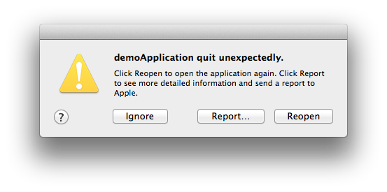
Qt Debugging Aids – Asserts
Q_ASSERT and Q_ASSERT_X
Uses qFatal(), which aborts the application, when the default message logger used
Q_ASSERT_X(1 > 2, Q_FUNC_INFO, "False condition");
// Q_ASSERT(false);
// Outputs:
ASSERT failure in int main(int, char **): "False condition",
file ../demoApplication/main.cpp, line 17
The program has unexpectedly finished.

Slide 42
Qt Debugging Aids – Debug Dumps
Each QObject can be named with QObject::setObjectName()
The name can be retrieved with QObject::objectName()
As a lot of the debugging information is only really helpful if these names are set, it is good Qt programming style to do so
Debug dumps
Work only in debug builds
QObject::dumpObjectInfo() dumps information about object internals, like signals/slots
QObject::dumpObjectTree() dumps the parent/child relationships of all descendant objects
OBJECT QApplication::unnamed
SIGNALS OUT
signal: destroyed(QObject*)
signal: destroyed()
signal: objectNameChanged(QString)
QApplication::
QCocoaEventDispatcher::
QSessionManager::
QMacStyle::macintosh

Slide 43
Questions And Answers
What is Qt?
What licenses can be used with Qt?
Which code lines do you need for a minimal Qt application?
What is a .pro file?
What is qmake, and when is it a good idea to use it
What is a Qt module and how to enable it in your project
How can you include a QLabel from the QtGui module
Name places where you can find answers about Qt problems

Slide 44
Summary
Qt is a cross-platform framework, allowing the same code to be built and run in desktop, embedded, and mobile platforms
Qt has a large selection of libraries, providing developers with some 1,500 C++ classes
In addition to class libraries, Qt framework contains several development tools, like Qt Creator IDE
Qt is available under commercial and open source licenses
GUI application can be written with C++ widgets, with QML or with web technologies
There is a large and active developer community around Qt

Slide 45
Qt Object Model

Slide 46
Contents
Qt's Object Model
Object Communication
Signals and Slots
Event Handling

Slide 47
Objectives
Learn…
... about Qt objects
… memory management with object trees and Qt smart pointers
… how objects can communicate
… what signals & slots are
... how to use signals & slots for object communication
... which variations for signal/slot connections exist
... how to create custom signals & slots
... how Qt handles events

Slide 48
Qt’s Object Model
Qt’s 1,500 classes can be divided into two groups
Identity types
Value types
Identity types
derive from QObject
extend C++ with many dynamic features using a meta-object system
cannot be copied as the copy constructor and assignment operator equal to delete
QWidget, QWindow, QApplication, QEventLoop, QThread, QFile, QTcpSocket
Value types are standard C++ classes
QColor, QEvent, QDataStream, QMetaType
~100 value types use copy-on-write pattern – implicitly shared
QString, QByteArray, QList, QVector, QHash, QCache, QDir, QPixmap, QImage, QBrush, QPen

Slide 49
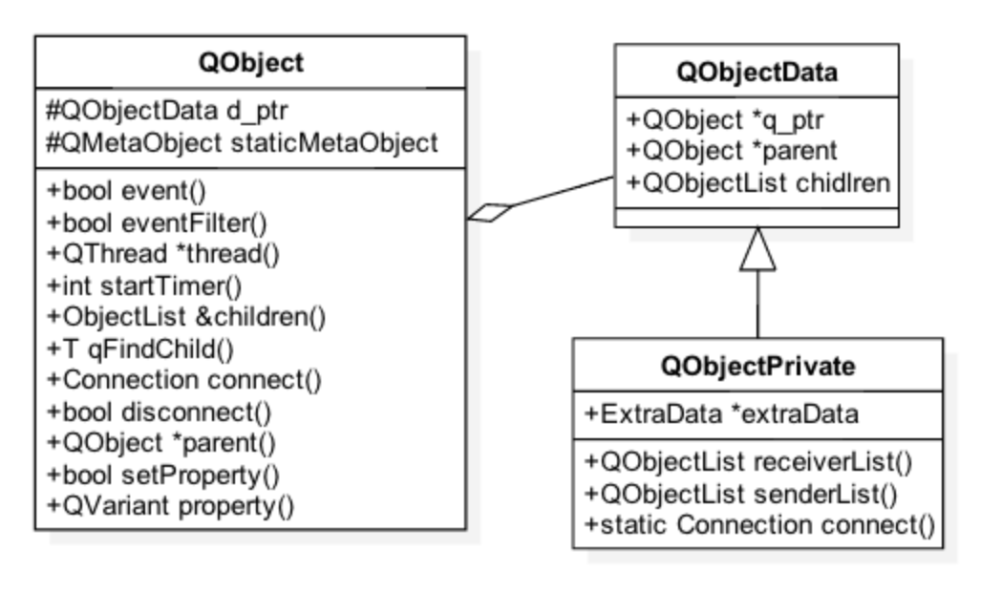
QObject – Heart of Qt’s Object Model
Extends Qt with dynamic features, useful in GUI programming
Object tree
Thread-safe and type-safe object communication – signals and slots
Event handling
String localization
Object properties
Safe static cast – qobject_cast
Internal timer
Qt objects use P-IMPL pattern to guarantee binary compatibility

Slide 50
Object Tree
QObjects organize themselves in object trees
Based on parent-child relationship
QObject(QObject *parent = Q_NULLPTR)
Parent adds object to list of children
const QObjectList &children();
QList<QWidget> findChildren();
Parent owns children
Construction/Destruction
Tree can be constructed in any order
Tree can be destroyed in any order
if object has parent: object first removed from parent
if object has children: deletes each child first
No object is deleted twice
Note: Parent-child relationship is NOT inheritance
QObject
parent
QObject
child
QObject
child (parent)
QObject

Slide 51
Object Creation
On Heap - QObject with parent:
QObject *object = new QObject(parent);
On Stack - QObject without parent:
QFile, usually local to a function
QApplication, local to main()
Top level widgets : QMainWindow window; // No parent
On Stack - value types
QString name;
QStringList list;
QColor color;
Passed by value everywhere
QString and QStringList implicitly shared
Stack or Heap - QDialog - depending on lifetime
ex-object-creation

Slide 52
Object Deletion – deleteLater()
An object must not be deleted, while it is handling an event
QObject::deleteLater() slot schedules the object for deletion
The object deleted, when the control returns to the event loop
If the thread does not have an event loop, the object deleted when the thread finishes
connect(threadPtr, &QThread::finished, threadPtr, &QThread::deleteLater);
At least one event loop must be running or started later
Otherwise the object is not deleted
Calling deleteLater() more than one for the same object does not cause double deletion

Slide 53
Object Deletion – QPointer
Object tree does not solve the dangling pointer problem
QPointer provides a guarded pointer for QObject
Sets pointer to 0, when the referenced object destroyed
Easy to mix guarded and normal pointers
Guarded pointer automatically cast to the pointer type
Qt objects may also notify observers just before their destruction
// ExampleObject is just QObject subclass
QPointer<ExampleQObject> object(new ExampleQObject);
delete object;
if (object)
qDebug() << ”Dangling pointer";
else
qDebug() << "No dangling pointer";
ex-object-creation

Slide 54
Object Deletion – QScopedPointer
Deletes the referenced object, when the pointer goes out of the scope
Unlike QPointer, can be used for any type
Four different cleanup handlers
QScopedPointerDeleter
QScopedPointerArrayDeleter
QScopedPointerArrayDeleter
QScopedPointerDeleteLater
QScopedPointer<int, QScopedPointerArrayDeleter<int>> intArrayPointer(new int(100));
Useful in functions with several exit paths
E.g. exceptions
Simplifies the code
Often used to delete dynamically allocated member variables as well

Slide 55
Data Sharing
Data sharing
Shared data pointer does not get destroyed, if there are any references to it
No need to worry who deletes the data and when
Strong and weak data pointers
Implicit sharing
Similar to data sharing, but data gets automatically copied, if any referencing object changes the data
Explicit sharing
Similar to implicit sharing, but data is never copied implicitly
QSharedPointer<MyObj> sharedPointer =
QSharedPointer<MyObj>(new MyObj, &QObject::deleteLater);
QWeakPointer<MyObj> weakPointer(sharedPointer);
if (weakPointer)
// Referenced object still exists
ex-smartPointers

Slide 56
Object Communication

Slide 57
Communication between Qt Objects
Between objects
Signals & Slots
Between Qt and the application
Events
Between Objects on threads
Signal & Slots + Events
Between Applications
D-Bus, sockets, shared files, process standard input/output, QSharedMemory

Slide 58
Callbacks
How do you get from "the user clicks a button" to your business logic?
Possible solutions
Callbacks
Based on function pointers
Not type-safe
Observer Pattern(Listener)
Based on interface classes
Needs listener registration
Many interface classes
Qt uses
Signals and slots for high-level (semantic) callbacks
Virtual methods for low-level (syntactic) events

Slide 59
Object Communication with Signals and Slots
A signal is a way to notify an observer that something has happened
A mouse pressed on a UI control, for example
Signals are member functions that are automatically implemented in the meta-object
Signal is sent, or emitted, using the keyword emit or Q_EMIT - actually does not do anything
Q_EMIT someSignal(7, “Hello”);
A slot is a function that is to be executed after a signal has been emitted
On a mouse press, start an animation
A slot function may be a member function, a non-member function or a lambda function
Signals are connected to other signals or slots
Many-to-many relationship
Signal and slot parameter types must match, but the slot may omit any number of trailing parameters

Slide 60
Qt Object Class Declaration with Signals and Slots
class CustomObject : public QObject
{
// Q_OBJECT macro defines among other things a static meta object
// Required for signals and string-based slots
Q_OBJECT
public:
explicit CustomObject(QObject *parent = 0) : QObject(parent), m_value(42) { }
Q_SIGNALS: // Macro expands to public void
simpleSignal(int, const QString &); // Or alternatively Q_SIGNAL prefix
// Slots are often setters
public Q_SLOTS: // Or alternatively Q_SLOT prefix
void setValue(int value) { if (value != m_value) m_value = value; } private:
int m_value;
};

Slide 61
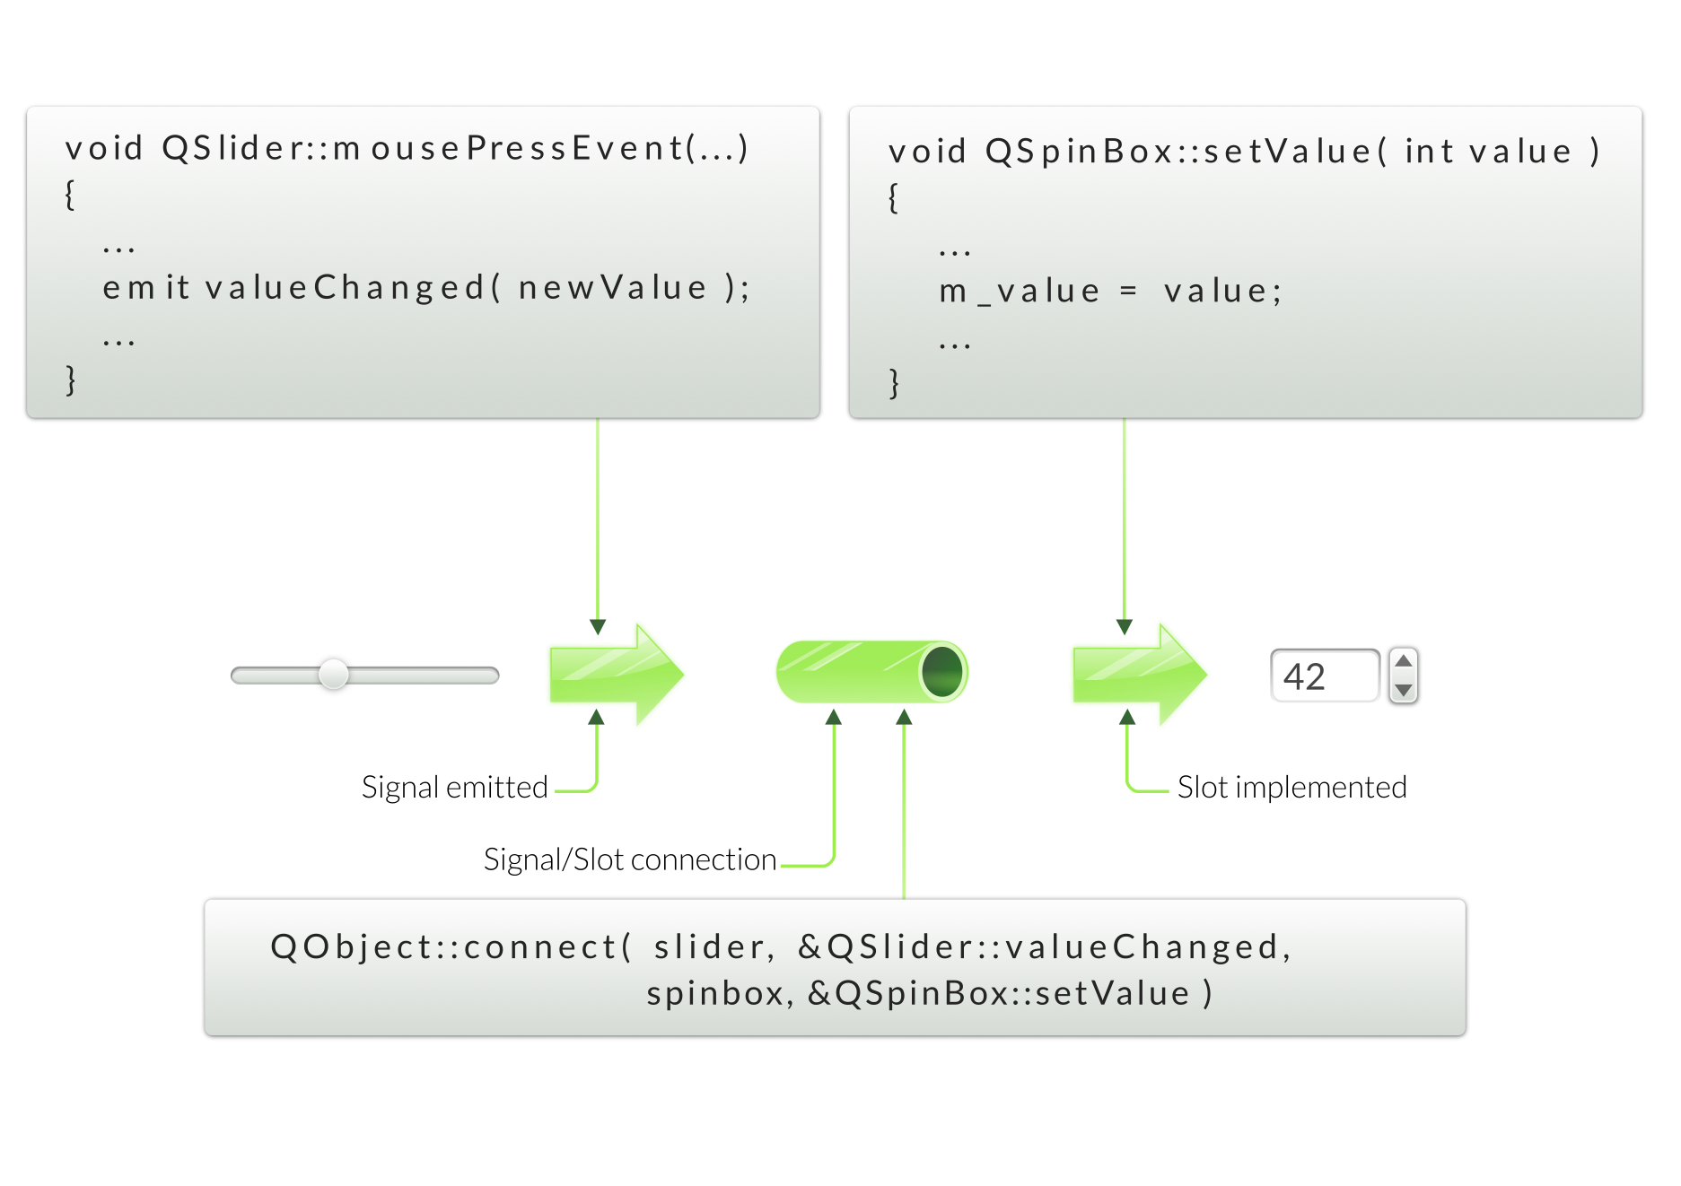
Connecting Signals to Slots
ex-connect

Slide 62
Signal Slot Connection Variants
String-based connection:
connect(slider, SIGNAL(valueChanged(int)), spinbox, SLOT(setValue(int)));
Using pointers to member functions:
connect(slider, &QSlider::valueChanged, spinbox, &QSpinBox::setValue);
Using non-member function:
static void printValue(int value) {...}
connect(slider, &QSignal::valueChanged, &printValue);
Using lambda functions:
connect(slider, &QSlider::valueChanged, [=] (int value) {...} );

Slide 63
Connect – Pointers to Member Functions
Qt5 components
connect(slider, &QSlider::valueChanged, spinbox, &QSpinBox::setValue);
Overloaded functions:
connect(spin, qOverload<int>
(&QSpinBox::valueChanged), slider, &QSlider::setValue);
connect(spin, static_cast<void (QSpinBox::*)(int)>
(&QSpinBox::valueChanged), slider, &QSlider::setValue);
Primary choice when connecting objects
√ Compile time errors √ No special syntax for slots
√ Q_OBJECT not need for slots
ex-connect-function-pointers

Slide 64
Connect – String-based Connections
Used in Qt4, still used in connecting to slots in QML:
connect(slider, SIGNAL(valueChanged(int)), spinbox, SLOT(setValue(int)));
Receiving object:
X Need to declare the slot in a Q_SLOTS section
X Need the Q_OBJECT macro X Need to have moc run on it
X Only run-time errors √ Overloaded slots are easy √ Existing Qt4 code do not need to be rewritten
ex-stop-watch

Slide 65
Connect – Non-Member
Using non-member functions:
static void printValue(int value) {
qDebug( "value = %d", value );
}
connect(slider, &QSignal::valueChanged, &printValue);
√ No slots syntax, no Q_OBJECT, no moc √ Compile time errors √ Any function, e.g. the return value of std::bind
ex-connect-non-member

Slide 66
Connect – Lambda Functions
Using lambda functions:
Add CONFIG += c++11 to your project file, if working prior Qt 5.7
connect(slider, &QSlider::valueChanged,
[] (int value) { qDebug("%d", value); });
√ No slots syntax, no Q_OBJECT, no moc √ Compile time errors √ No need for an extra function
ex-connect-lambda

Slide 67
Variations of Signal/Slot Connections
Signal | Connect to | Slot(s)
one | √ | many
many | √ | one
one | √ | another signal
rangeChanged(int,int) | √ | setRange(int,int)
rangeChanged(int,int) | √ | update()
valueChanged(int) | √ | setValue(int)
valueChanged(int) | √ | update()
valueChanged(int) | X | setRange(int,int)
valueChanged(int) | √ | setValue(float)
textChanged(QString) | X | setValue(int)

Slide 68
Connection Types
Qt::AutoConnection – the default connection type
Actual connection type determined, when a signal is emitted
Connection type depends on signaling and receiving objects’ thread affinity
Qt::DirectConnection - An immediate slot function call
Qt::QueuedConnection – A delayed function call
Signaling object sends an event to the receiving object
Qt::BlockingQueuedConnection – Signaling thread blocks, until the slot is executed
Qt::UniqueConnection – Prevents multiple instances of the same connection

Slide 69
Disconnecting Signals
Disconnect everything connected to an object’s signals
disconnect(senderObject, 0, 0, 0);
// sender (cannot be 0), signal, receiver, slot
Disconnect everything connected to a specific signal
disconnect(senderObject, &Object::theSignal, 0, 0);
Disconnect a specific receiver
disconnect(senderObject, 0, receiver, 0);
Disconnect a specific connection
disconnect(senderObject, &Object::theSignal, receiver, &Object::theSlot);
If connected to lambda expressions, use the following overloaded version of the disconnect() function:
bool QObject::disconnect(const QMetaObject::Connection &connection);

Slide 70
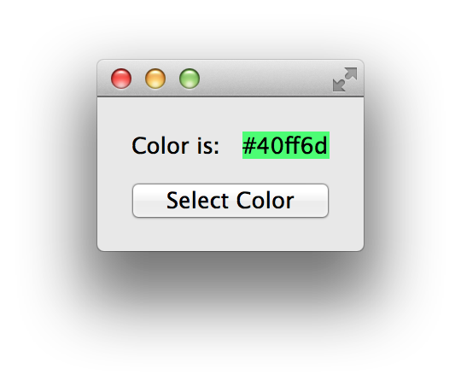
Lab – Connect to Click
Create an application as shown here
Clicking on ”SelectColor” updates label with color's name
Hints
QColorDialog::getColor()to fetch a color
QColor::name()to get the color name
Optional
In QColorDialog, honor the user clicking ”cancel”', and provide it with the current color to start from
Set the selected color as the label's background
Hint: see QPalette
Hint: see QWidget::setAutoFillBackground()
lab-selectcolor

Slide 71
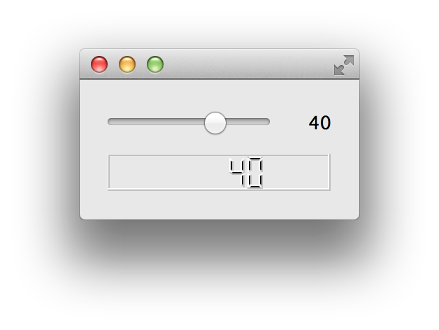
Lab – Source Compatibility
Implement custom slider
API compatible with QSlider
Shows current value of slider
To create custom slider
Use QSlider and QLabel
To test slider
main.cpp provides test code
QLCDNumber is part of test code
Optional:
Discuss pros and cons of inheriting from QSlider instead of using an instance in a layout
lab-slider

Slide 72
Event Handling

Slide 73
Event Processing
Qt is an event-driven UI toolkit
QCoreApplication::exec() runs the event loop
Generate Events
By input devices: keyboard, mouse, etc.
By Qt itself (e.g. timers)
Queue Events
By event loop
Dispatch Events
By QApplication to receiver: QObject
Key events sent to widget/Qt Quick item with focus
Mouse events sent to widget/Qt Quick item under cursor
Handle Events
By QObject event handler methods

Slide 74
Event Processing
Application process
Events/signals to other objects
GUI events
Qt GUI
QWindow
QWidget / QQuickItem
Qt Core
QCoreApplication – runs the event loop
paints
Qt Platform Abstraction plugin
Platform-specific event dispatcher
Backing store / OpenGL context
events
Platform APIs
Platform-specific window system / frame buffer

Slide 75
1. Generate Events
Spontaneous events
Asynchronous, e.g. mouse, touch or key press events
Generated by the underlying window system
Read and queued by a QPA plug-in
Processed by the event loop
Synthetic events
Created in Qt program
Synchronous or asynchronous

Slide 76
Synchronous and Asynchronous Events
Asynchronous synthetic events
Queued by Qt and processed by the event loop
In some cases Qt can compress several posted events into one!
E.g., queued connections, QWidget::update(), QQuickItem::update()
Queued with QCoreApplication::postEvent(QObject *receiver,
QEvent *event,
int priority = Qt::NormalEventPriority)
Synchronous synthetic events
Sent directly to the target object
E.g., QWidget::repaint()
Sent with QCoreApplication::sendEvent(QObject *receiver,
QEvent *event)
In some cases it is simpler to use signals and slots than sending and posting signals
ex-synthetic-events

Slide 77
2. Queue Events
Spontaneous and asynchronous synthetic events queued by the event loop
QCoreApplication::exec()runs the main event loop
The event loop tells the event dispatcher what to do and how to do it
For example: wait for an event, exclude user input events
QCoreApplication – runs the event loop
Platform-specific event dispatcher
Platform-specific window system / frame buffer

Slide 78
Event Loops
All event loops in Qt are represented by the class QEventLoop
QEventLoop can be used to launch local event loops
Event loop is modal
QApplication::exec(), QEventLoop::exec(), etc. are blocking
QDialog, QMenu also have exec() functions
Continues processing until told to stop by calling exit()
Event-loop is recursive
Any of the exec() functions can re-curse
Except for QApplication::exec()
Use with caution, unexpected recursion can happen
ex-event-loop

Slide 79
3. Dispatch Events
Platform-specific event dispatchers derived from QAbstractEventDispatcher
Event dispatcher receives events from the window system and other sources via the event loop
Delivers events to QCoreApplication

Slide 80
Event Processing in Long-Running Tasks
It is possible to process events during long-running tasks
QAbstractEventDispatcher::processEvents(QEventLoop::ProcessEventsFlag flags)
For example, show progress indicator, blocking user interaction, in a single-threaded application
QCoreApplication::processEvents(QEventLoop::ExcludeUserInputEvents)
Or check, if a timer event occurred in a worker thread running a task
QAbstractEventDispatcher *dispatcher = QThread::eventDispatcher();
dispatcher->processEvents(QEventLoop::AllEvents);

Slide 81
4. Event Handling
Dispatcher delivers all events of all application threads to QCoreApplication::notify()
Can be used to check, if a certain event exists, for example
After notify all GUI thread events are delivered to application-global event filters, if there are any
Object-specific event filters receive the event after application-global event filters
If none of the event filters remove the event, receiving object’s event() function gets called
In case of a custom event, receiver object’s customEvent() receives the event
ex-event-handling

Slide 82
Event Handling
bool QObject::event(QEvent *) handles all events for this object
Re-implement for custom event handling
For example, to handlle touch events and gestures in widgets
Returning false results that the event is propagated to a parent
Specialized event handlers for QWidget and QQuickItem
void mousePressEvent(QEvent *) for mouse clicks
void keyPressEvent(QEvent *) for key presses
void touchEvent(QEvent *) for touch handling in QQuickItem only
Event accepted by default
Ignored events propagated to a parent
QEvent::accept()/QEvent::ignore()
ex-all-events

Slide 83
Accepting and Ignoring QCloseEvent
QCloseEvent delivered to top level widgets (windows)
Accepting event allows window to close
Ignoring event keeps window open
void Widget::closeEvent(QCloseEvent *event)
{
if (windowShouldClose())
event->accept();
else
event->ignore();
}
ex-close-event

Slide 84
Event Filters
Sometimes you need to add the same functionality to a number of different widgets
All widgets reacting on a certain event the same way
…or you might want block/hijack events aimed at a certain widget
E.g. a QPushButton on the screen
The usual way to do this is to subclass each widget and re-implement the required event handler function(s)
May be cumbersome if all you try to obtain is the possibility to e.g. add common mouse movement handling to widgets or block certain events
The solution: use one or more event filters

Slide 85
Event Filters
Any Qt object, re-implementing the eventFilter() function and installed to one or more Qt objects
bool eventFilter(QObject *receiver, QEvent *event)
This method returns true if the filter handles the given event, false otherwise
QObject::installEventFilter(QObject *targetObject)
An application-global event filter is installed on the QCoreApplication instance
Avoid in general because of increased event handling time
Good for debugging – e.g. is there a certain event type or not?

Slide 86
Further Notes
Events are not handled at all for objects whose thread affinity is NULL (i.e. do not belong to any thread)
An object and its event filter need to be in the same thread (i.e. have the same thread affinity) - otherwise QObject::installEventFilter() does nothing
Furthermore, if one of them is moved to another thread after installation, the event filter will not be called before both are in the same thread again
The filter is not removed by Qt
ex-event-filter

Slide 87
Questions And Answers
How do you connect a signal to a slot?
How would you implement a slot?
How would you emit a signal?
Can you return a value from a slot?
When do you need to run qmake
Where do you place the Q_OBJECT macro and when do you need it?
What is the purpose of the event loop
How does an event make it from the device to an object in Qt?

Slide 88
Summary
Between objects
Signals & Slots
Between Qt and the application
Events
Between Objects on threads
Signal & Slots + Events

Slide 89
Lab – Event Handling
You may build and run the lab project
Add the following functionality without sub-classing
If the left mouse button is clicked on the quote button, the window is moved to the left
Right click on the button moves the window to the right
In your event handler
Check the event type – QEvent::type()
In case of mouse press event, cast the event to mouse event
Cast the receiver Qt object to QWidget
Check, which mouse button is pressed (Qt::LeftButton or Qt::RightButton)
Get the widget position with QPoint QWidget::pos() and move it with move(int x, int y)
Add any other functionality, possibly required by your event handler
lab-event-handling

Slide 90
Meta-Object and Meta-Type Systems

Slide 91
Contents
Meta-Object System
Property System
Enumerations
Variants
Meta-Type System

Slide 92
Objectives
Learn…
…Qt object properties and their usage
... about QVariant and meta-type system
… how to register custom value types
…benefits of using QVariant

Slide 93
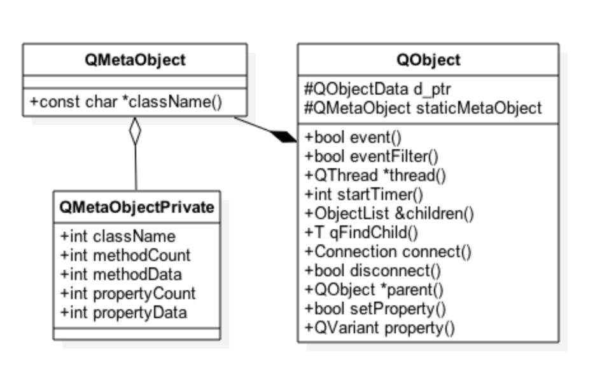
Meta-Object System
Adds dynamic features to Qt objects
Features can be introspected via QMetaObject
Class and parent class names
Class info
Method information
Type: constructor, signal, slot, method
Signature
Properties
Enumerations and flags
Q_OBJECT macro defines a static meta-object
Actual object data generated with the moc tool

Slide 94
Qt Object Class Declaration – QWindow
Q_OBJECT macro
One enum added to the meta-object
Signals and slots
Properties
class Q_QUICK_EXPORT QQuickWindow : public QWindow
{
Q_OBJECT // Defines a static meta-object for the class
Q_PROPERTY(QColor color READ color WRITE setColor NOTIFY colorChanged)
Q_PROPERTY(QQuickItem* contentItem READ contentItem CONSTANT)
public:
enum SceneGraphError { ContextNotAvailable = 1 };
Q_ENUM(SceneGraphError)
Q_SIGNALS:
void frameSwapped();
void openglContextCreated(QOpenGLContext *context);
void sceneGraphInitialized();
public Q_SLOTS:
void update();

Slide 95
QMetaObject
Contains meta-information about Qt objects
Allows object introspection
const char *QMetaObject::classname();
bool QMetaObject::inherits(const QMetaObject *metaObject)
Qt object may contain any custom information in <name, value> pairs
E.g., Q_CLASSINFO(“author”, “Qt Developer”);
QMetaClassInfo QMetaObject::classInfo(int index) const

Slide 96
Object Introspection
QString objToString(const QObject *obj)
{
QStringList result;
const QMetaObject *meta = obj->metaObject();
result += QString("class %1 : public %2 {")
.arg(meta->className())
.arg(meta->superClass()->className());
for (auto i=0; i < meta->methodCount(); ++i)
{
const QMetaMethod method = meta->method(i);
const QMetaMethod::MethodType methodType = method.methodType();
if (methodType == QMetaMethod::Signal)
signalPrefix = QStringLiteral("Q_SIGNAL");
else if (methodType == QMetaMethod::Slot)
signalPrefix = QStringLiteral("Q_SLOT");
result += QString(" %1 %2 %3;")
.arg(signalPrefix)
.arg(QVariant::typeToName(method.returnType()))
.arg(QString(method.methodSignature()));
}
ex-object-introspection

Slide 97
QMetaObject – Method Invocation
Any Qt object method marked as Q_SLOT or Q_INVOKABLE can be invoked
Provided allowed by method access specifiers
bool QMetaObject::invokeMethod(QObject *object,
const char *member,
Qt::ConnectionType type,
QGenericReturnArgument ret,
QGenericArgument val0, …)
Generic return values and arguments can be defined with corresponding macros
Q_RETURN_ARG(Type, const Type &value) // Q_RETURN_ARG(int, x)
Q_ARG(Type, const Type &value)

Slide 98
Property System
Allows Qt objects to expose data as properties
Exposed properties are not limited to data members
Platform and compiler independent
Property access does not require any knowledge of the Qt object type
Used by many Qt frameworks
Animation framework animates Qt object properties
Style sheets can be used to assign values to properties
QML engine manages property bindings between Qt objects

Slide 99
Providing Properties from QObject
Q_PROPERTY(Type name
(READ getFunction [ WRITE setFunction ] |
MEMBER memberVariable [( READ getFunction | WRITE setFunction )])
// MEMBER is straightforward mapping to a member variable
// If any processing is required, use READ / WRITE
[ RESET resetFunction ] // Implemented, if reset is different from WRITE
[ NOTIFY notifySignal ] // Emitted, when the property value changes
[ REVISION int ] // Used often in QML to define API revision
[ DESIGNABLE bool ] // Property accessible in Qt Designer
[ SCRIPTABLE bool ] // Property accessible in Qt Script
[ STORED bool ] // False, if property not stored by object
[ USER bool ] // One essential property can be marked USER
[ CONSTANT ] // Constant property, no WRITE or NOTIFY
[ FINAL ] // Property not overridden in subclasses

Slide 100
Providing Properties from QObject
class ExampleQtObject : public QObject
{
Q_OBJECT
Q_PROPERTY(Employee employee MEMBER m_employee NOTIFY employeeChanged)
Q_PROPERTY(AQtObject *objectProperty MEMBER m_object NOTIFY objectPropertyChanged)
public:
explicit ExampleQtObject(QObject *parent = 0);
Q_SIGNALS:
void employeeChanged(); void objectPropertyChanged ();
private:
Employee m_employee;
AQtObject *m_object;
};
ex-properties

Slide 101
Accessing Properties
Property access methods
Take QVariant argument and return QVariant type
If name is not declared as a Q_PROPERTY
->dynamic property
Not accessible from Qt Quick
Note:
Q_OBJECT macro required for properties to work
QMetaObject knows nothing about dynamic properties
QVariant property(const char* name) const;
void setProperty(const char* name, const QVariant &value);

Slide 102
Enumerations
Enumerations and flags can be made accessible via the meta object
Can be used as property types as well
Q_ENUM – registers the enum type with both the meta-object and meta-type system
Q_FLAG – Registers flags (defined as Q_DECLARE_FLAGS) using Q_ENUM
class ExampleQtObject : public QObject
{
Q_OBJECT
Q_PROPERTY(Regions regions MEMBER m_regions NOTIFY regionsChanged)
public:
explicit ExampleQtObject(QObject *parent = 0); enum Region { Africa = 0x01, Americas = 0x02, Asia = 0x04, Australia = 0x08 };
Q_DECLARE_FLAGS(Regions, Region)
Q_FLAG(Region) // Q_FLAG registers the enumeration using Q_ENUM Q_SIGNALS:
void regionsChanged(); private:
Regions m_regions;
};
ex-properties

Slide 103
Variants
QObject property types can be any type, supported by QVariant
Union for common Qt "value types” (copyable, assignable)
Value type, supporting implicit sharing
Custom types can be added
Based on the meta-type system
Extends dynamic features to value types

Slide 104
Using Variants
Easy to create QVariant objects as the inverse conversion is automatic for all supported data types
QVariant variant = QColor(Qt::red);
QVariant anotherVariant = QPixmap(QStringLiteral(“image.png”));
qDebug() << anotherVariant.typeName(); // Logs “QPixmap”
CustomType customValueType;
QVariant yetAnotherVariant = QVariant::fromValue(customValueType);
Conversion functions exist for QtCore types
For other types use template functions
QString string = variant.toString(); // QString is a type in Qt Core
// QSettings store <key, value> pairs and QSettings::value() returns QVariant
QFont textFont = settings.value(“TextFont”).value<QFont>());
ex-variants

Slide 105
Meta-Type System
QMetaType manages named types
Types known by QMetaType can be accessed using QVariant
Provides registered types a char * name and int identifier
Allows creating, destroying, copying, and serializing assignable types
Custom types can be added to the meta-type system with Q_DECLARE_METATYPE(Type)
Custom streaming operators, type converter, and equality comparison functions may be registered
Makes value types dynamic
Completes introspection functionality to non-QObject types by associating a type name to a type
#include <QMetaType>
class Contact {
// Class declaration
};
Q_DECLARE_METATYPE(Contact);

Slide 106
Custom Types and QVariant
Contact contact;
contact.setName("Peter");
QVariant variant = QVariant::fromValue(contact); // Custom type
Contact contact2 = variant.value<Contact>();
qDebug() << contact2.name(); // "Peter"
qDebug() << variant.typeName(); // prints "Contact"
int type(variant.userType()); // 1025 (QMetaType::User + 1)
qDebug() << qRegisterMetaType<Contact>() << qMetaTypeId<Contact>();
// New object created using int identifier
Contact *contact3(static_cast<Contact *>(QMetaType::create(type)));
contact3->setName("Ann");
ex-meta-type-system

Slide 107
Limitations on Custom Types
Parameters in queued connections must be known by the meta type system
Parameters serialized into an event, which is passed between a signalling and receiving objects
Parameter objects re-created in the receiving object and parameters de-serialized from the event
Add your custom type to the meta-object system using Q_DECLARE_METATYPE()
Additionally, call qMetaTypeId<MyType>() or qRegisterMetaTyoe<TypeDef>() before making the first queued connection, if the signalling and receiving objects are in separate threads
This will enable run-time name resolution
ex-custom-data-in-connections

Slide 108
Questions and Answers
What benefits are there in Qt property system?
Are there any drawbacks?
Where properties are used in Qt?
What kind of classes can be used as properties?
Is it possible to use Qt objects as properties? Why or why not?
How custom types can be used as properties?
What is QVariant?
How and where QVariant is used?
How QVariant is related to meta-type system?
When is it required to register custom types with qMetaTypeId() or qRegisterMetaType()?

Slide 109
Summary
Qt Object properties allow accessing object data without knowing the actual type of the object
Several frameworks in Qt use properties
Property animations
Style sheets
QML
Any type, known by QVariant (meta-type system) can be used as a property
QVariant extends object introspection to value types
Value types are given an char pointer name and integer identifier
Custom assignable types can be registered to the meta-type system

Slide 110
Core Classes

Slide 111
Contents
String Handling
Handling Files
Item Containers

Slide 112
Objectives
Learn…
...how to use and manipulate string efficiently in Qt
…file usage and data streaming
…Qt item containers
…best practices with item containers
…Java-style iterators

Slide 113
String Handling

Slide 114
QString and QByteArray
Container for 16-bit Unicode 4.0 QChars
Support for 32-bit unicode characters
Uses QTextCodec to interpret characters
QByteArray provides a container for raw data and 8-bit characters
May be used in programs with strict memory requirements
Both classes implicitly shared
QString string1("abc"); // Makes a deep copy of “abc”
QString string2(string1); // Makes a shallow copy of string1
Both strings share the same data, until either string changes the shared data
ex-codec

Slide 115
String Creation
Strings can be created in a number of ways:
Conversion constructor and assignment operators:
QString emptyAndNullString; QString emptyString(“”);
QString str("abc"); // Uses QString::fromUtf8() function
str = "def”;
From a char pointer using the static functions:
QString text = QString::fromLatin1("Hello Qt");
QString text = QString::fromUtf8(inputText);
QString text = QString::fromLocal8Bit(cmdLineInput);
QString text = QStringLiteral("Literal string"); (Assumed to be UTF-8)

Slide 116
String Creation
From a number overloaded static functions
QString n = QString::number(1234); // (u)int, u(long), double
From char pointer with translations:
QString text = QObject::tr("Hello Qt");
From standard strings
QString string(QString::fromStdString(std::string("hello")));
QString string(QString::fromStdU16String(u"Europe:\u20ac Japan:\u00a5"));
QString string(QString::fromStdU32String(U"Europe:\u20ac Japan:\u00a5"));

Slide 117
String Creation and Performance
QString is “expensive” to create from double-quoted ASCII literals
String allocation, deep copy of the data, decoding using the selected codec
Automatic conversion can be disabled with DEFINES += QT_NO_CAST_FROM_ASCII
In this case, QLating1String can be used as a thin wrapper to const char * string
Avoid creating temporary QString objects
Many member functions (assignment, comparison, insert, replace etc.) work directly with const char * without a conversion to QString
Faster to compare QString as aStr == “hello” or aStr == QLatin1String(“hello”) than aStr == QString(“hello”)
QStringLiteral macro generates data for a QString at compile-time
Light-weight to create a QString using QStringLiteral
ex-string-creation

Slide 118
Text Processing with QString
operator+ and operator+=
QString str = str1 + str2;
fileName += ".txt";
simplified() // removes duplicate whitespace
left(), mid(), right() // part of a string
leftJustified(), rightJustified() // padded version
QString s = "apple";
QString t = s.leftJustified(8, '.'); // t == "apple..."
For heavy string processing, like a parser, use QStringRef
Reduces the number of memory allocations, but may result to more complicated code

Slide 119
Extracting Data from the Strings
Numbers:
QString text = ...;
nt value = text.toInt();
float value = text.toFloat();
Strings:
QString text = ...;
QByteArray bytes = text.toLatin1();
QByteArray bytes = text.toUtf8();
QByteArray bytes = text.toLocal8Bit(); // bytes = qPrintable(text);
Characters:
const QChar char = text.at(42);
QCharRef char = text[42]; // Allows modifying text

Slide 120
QStringView
Unified view on UTF-16 strings
Designed as an interface type
No need to construct QString
Allows a single function to accept a wide variety of UTF-16 string data source
void stringFunc(QStringView sv); // Most efficient as passed by value
QLatin1String is as efficient wrapper for const char * Latin1 strings

Slide 121
QByteArray
Obtaining raw character data from a QByteArray:
char *str = bytes.data();
const char *str = bytes.constData();
Macro for generating data for a byte array at compile time – QByteArrayLiteral
WARNING:
Character data is only valid for the life time of the byte array
Calling a non-const member of bytes also invalidates the pointer
Either copy the character data or keep a copy of the byte array

Slide 122
Formatted Output with QString::arg()
int i = ...; int total = ...;
QString fileName = ...; QString status = tr("Processing file %1 of %2: %3”).arg(i).arg(total).arg(fileName); double d = 12.34;
QString str = QString::fromLatin1("delta: %1").arg(d,0,'E',3);
// str == "delta: 1.234E+01"
Safer: arg(QString,...,QString)(“multi-arg()”)
But: only works with QString arguments
Strings may be formatted using similar syntax to printf() – QString::asprintf();
Prefer QString.arg() in new code, because it supports unicode seamlessly and is type-safe

Slide 123
Text Processing with QString
length()
endsWith() and startsWith()
contains(), count()
indexOf() and lastIndexOf()
Expression can be characters, strings, or regular expressions

Slide 124
Text Processing with QStringList
QString::split(), QStringList::join()
QStringList::replaceInStrings()
QStringList::filter()

Slide 125
Text Processing with Regular Expressions
QRegularExpression supports
Regular expression matching
Wildcard matching
QRegularExpression rx("^\\d\\d?$"); // match integers 0 to 99
rx.match("123"); // QRegularExpressionMatch(Valid, no match)
rx.match("-6"); // QRegularExpressionMatch(Valid, no match)
rx.match("6"); // QRegularExpressionMatch(Valid, has match: 0:(0, 1, "6"))

Slide 126
Handling Files

Slide 127
Essential Classes
QDir
Navigate between folders – setPath(const QString &)
Qt uses “/” as a universal directory separator
Create, remove, and rename folders
Get file info – QFileInfoList QDir::entryInfoList()
Get files in the directory – QStringList QDir::entryList()
QFileInfo
File name, owner, group
Last modified, last read
Permissions, meta data changed time fields
QFile
Create, remove, rename files and create links
Read and write data

Slide 128
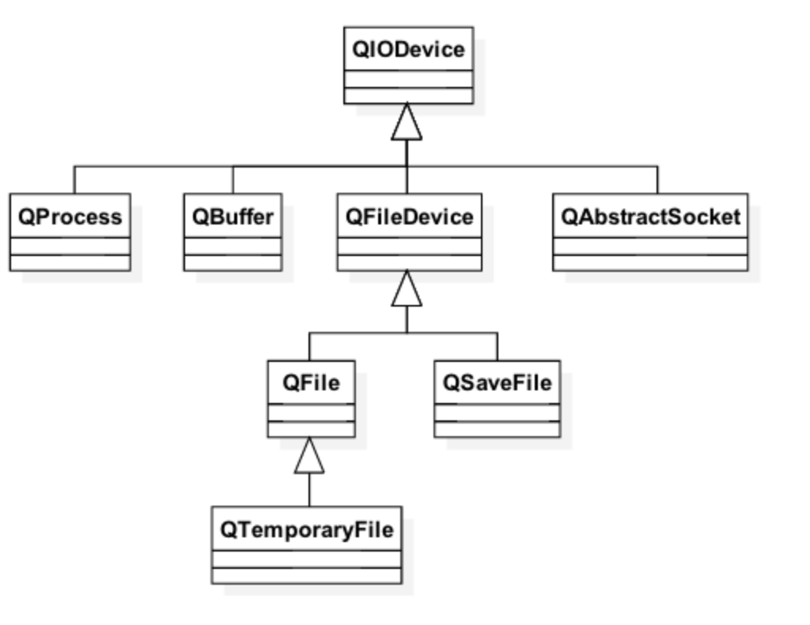
File I/O
QFile inherits QIODevice
QIODevice
Abstract class, used as an interface to provide device independent I/O features
By default file data is buffered
Buffering can be bypassed with Unbuffered open mode flag
Except in Windows, where data is always buffered

Slide 129
Reading and Writing Data with QIODevice
Variety of functions available
bool getChar(char *c), bool putChar(char c)
QByteArray readLine(qint64 maxSize)
qint64 read(char *data, qint64 maxSize)
qint64 write(const QByteArray *byteArray)
QByteArray readAll()
Position where data is written to or read from
Returned by qint64 pos()
qint64 bytesAvailable() returns bytes available after the position
Position may be changed with seek(qint64 pos) or reset()
skip(qint64 maxSize)may improve performance in read operations
bool atEnd() returns true in the end of the file

Slide 130
File I/O
QFile file("data.txt");
if (!file.open(QFile::ReadWrite | QIODevice::Text)) ; // Handle error
const auto fileSize(file.size());
QByteArray readBuffer; // Read file character by character
char c;
while (file.getChar(&c))
readBuffer.append(c);
// Read data by chunks
readBuffer.clear();
file.reset();
const int bufferSize(10); // Intentionally extremely small for demo purposes
char chunk[bufferSize];
auto readBytes(0);
while ((readBytes = file.read(chunk, bufferSize)) > 0)
readBuffer.append(chunk, readBytes);
ex-file-io

Slide 131
Streaming
Data is often read and written using QDataStream or QTextStream
Add extra information about the data to the stream
Can operate with any QIODevice, a QByteArray or a QString
QTextSream
Convenient for reading and writing words, lines, and numbers
Commonly used to read console input and write to console output
Locale-aware
QDataStream
Portable between hardware architectures and operating systems
Format depends on the stream version used
Not human-readable
Complex types broken to primitive types, which are then serialized to the stream

Slide 132
Data Stream
Data data; // Custom assignable type, registered with the meta-type system
data.setString("Hello World");
data.setValue(42);
QTemporaryFile file;
if (!file.open()) { qDebug() << "Temp file opening failed."; return EXIT_FAILURE; }
QDataStream stream(&file);
// If a custom type is searilzed using QVariant,
// serialization operators need to be provided
#ifndef USE_VARIANT
stream << data;
#else
qRegisterMetaTypeStreamOperators<Data>("Data");
QVariant variantData(QVariant::fromValue(data));
stream << variantData;
#endif
ex-streaming

Slide 133
Memory-Mapped Files
Data manipulated via a memory pointer
Changes stored into a file
Unless the file is open in mode: QFileDevice::MapPrivateOption
Memory keeps mapped, until unmapped or file object destroyed
if (!file.open(QFile::ReadWrite | QIODevice::Text))
; // Error handling
uchar *mappedPointer = file.map(0, file.size());
QByteArray array(reinterpret_cast<char *>(mappedPointer));
array.replace("Dickens", "DICKENS");
memcpy(mappedPointer, array.constData(), file.size());
ex-memory-mapped-files

Slide 134
Item Containers

Slide 135
Container Classes
General purpose template-based container classes
QList<QString> - Sequence Container
Other: QVector, QLinkedList, QStack, QQueue...
QMap<int, QString> - Associative Container
Other: QHash, QSet, QMultiMap, QMultiHash, QCache
Qt's Container Classes compared to STL
Lighter, safer, and easier to use than STL containers
If you prefer STL, feel free to continue using it.
Methods exist that convert between Qt and STL
e.g. you need to pass std::list to a Qt method

Slide 136
Using Containers
Using QList
Using QMap
QList<QString> list({ "one", "two", "three" }); // list << "one" << "two"...
QString item1 = list[1]; // "two"
for (const QString &item : list) {
qDebug() << item; // Do somethinh with item reference
}
int index = list.indexOf("two"); // returns 1
QMap<QString, int> map({ { "Norway", 47 }, { "Italy", 39 } });
auto value = map["France"]; // inserts key if it does not exist
if (map.contains("Norway")) {
int value2 = map.value("Norway"); // recommended lookup
}

Slide 137
Algorithm Complexity
How fast is a function when number of items grow?
Sequential Container (all complexities are amortized )
Associative Container (all complexities are amortized )
 | Lookup | Insert | Append | Prepend
QList | O(1) | O(n) | O(1) | O(1)
QVector | O(1) | O(n) | O(1) | O(n)
QLinkedList | O(n) | O(1) | O(1) | O(1)
 | Lookup | Insert
QMap | O(log(n)) | O(log(n))
QHash | O(1) | O(n)

Slide 138
Storing Classes in Qt Container
Class must be an assignable data type
Class is assignable, if:
If copy constructor or assignment operator is not provided
C++will provide one (uses member copying)
If no constructors provided
Empty default constructor provided by C++
class Contact {
public:
Contact() {} // default constructor
Contact(const Contact &other); // copy constructor
// assignment operator
Contact &operator=(const Contact &other);
};

Slide 139
Requirements on Container Keys
Type K as key for QMap:
Type K as key for QHash or QSet:
Pay attention to the key type
It’s heavier to calculate hash value from QString than long
bool K::operator<(const K &)
bool operator<(const K &, const K &)
bool Contact::operator<(const Contact &c);
bool operator<(const Contact &c1, const Contact &c2);
bool K::operator==(const K &)
bool operator==(const K &, const K &)
uint qHash(const K &)

Slide 140
Memory Usage and Performance
QVector<T>, QString, and QByteArray store their items contiguously in memory
QList<T> maintains an array of pointers to the items it stores
Fast index-based access
Very memory efficient as an object
QList is beneficial for movable types of size void *
To avoid re-allocations, it is possible to reserve space for a list and vector
Still list data may require extra allocation for non-movable types
By default, a list allocates 4kB chunks for movable types and 50% more for non-movable types
A vector doubles its memory in re-allocation

Slide 141
Custom Types and Performance
Provide type information for your custom types
Allow Qt containers to choose appropriate storage methods
Q_DECLARE_TYPEINFO(Type, Flags)
Q_PRIMITIVE_TYPE
No constructor or destructor, typically enums and flags
memcpy() creates a valid independent copy of the object
Q_MOVABLE_TYPE
Type has constructor and/or destructor
Can be moved using memcpy()
Q_COMPLEX_TYPE (the default)
Type has constructor and/or destructor
May not be moved in memory

Slide 142
Iterators
Allow reading a container's content sequentially
Java-style iterators: simple and easy to use
QListIterator<...> for read
QMutableListIterator<...> for read-write
STL-style iterators slightly more efficient
QList::const_iterator, QList::const_reverse_iterator for read
QList::iterator(), QList::reverse_iterator for read-write
Same works for QSet, QMap, QHash, ...

Slide 143
Iterators Java style
Example QList iterator
QList<QString> list;
list << "A" << "B" << "C" << "D";
QListIterator<QString> iterator(list);
Forward iteration
while(iterator.hasNext()) {
qDebug() << iterator.next(); // A B C D
}
Backward iteration
iterator.toBack(); // position after the last item
while(iterator.hasPrevious()) {
qDebug() << iterator.previous(); // D C B A
}
A
B
C
D

Slide 144
Modifying During Iteration
Use mutable versions of the iterators (e.g. QMutableListIterator)
remove() and setValue()
Operate on items just jumped over using next() / previous()
insert()
Inserts item at current position in sequence
previous() reveals just inserted item
QList<int> list({ 1, 2, 3, 4});
QMutableListIterator<int> iterator(list);
while (iterator.hasNext()) {
if (iterator.next() % 2 != 0)
iterator.remove();
}
// list contains now 2, 4

Slide 145
Iterating Over QMap and QHash
next() and previous()
Return Item class with key() and value()
Alternatively use key() and value() from iterator
QMap<QString, QString> map;
map["Paris"] = "France";
map["Guatemala City"] = "Guatemala";
map["Mexico City"] = "Mexico";
map["Moscow"] = "Russia";
QMutableMapIterator<QString, QString> iterator(map);
while (iterator.hasNext()) {
if (iterator.next().key().endsWith("City"))
iterator.remove();
}
// map now "Paris", "Moscow"
ex-containers

Slide 146
STL-style Iterators
Example QList iterator
QList<QString> list;
list << "A" << "B" << "C" << "D";
QList<QString>::iterator iterator;
Forward mutable iteration
for (iterator = list.begin(); iterator != list.end(); ++iterator) {
*iterator = (*iterator).toLower();
}
Backward mutable iteration
iterator = list.end();
while (iterator != list.begin()) {
--iterator;
*iterator = (*iterator).toLower();
}
A
B
C
D
end

Slide 147
The Q_FOREACH Keyword
It is a macro, feels like a keyword
Q_FOREACH (const QString& string, list) {
if (string.isEmpty())
break;
qDebug() << string;
}
Modifying the container while iterating
Results in container being copied
Iteration continues in unmodified version
Not possible to modify item in the container
Do not copy the items –use const & to optimize performance
Prefer using the range-loop as Q_FOREACH will be removed in the future
for (const QString &string : list) { }

Slide 148
Algorithms
STL-style iterators are compatible with the STL algorithms
Defined in the STL <algorithm> header
Qt has own algorithms
Defined in <QtAlgorithms> header
Mostly deprecated!
For parallel (i.e. multi-threaded) algorithms use QtConcurrent name space
If STL is available on all your supported platforms you can choose to use the STL algorithms
The collection is much larger than the one in Qt

Slide 149
Algorithms
Sort items in a range: std::sort
Stable sort: std::stable_sort
Search for a value: std::find
Check if two ranges are the same: std::equal
Copy items from one range to another: std::copy
Copy backwards: std::copy_backward
Count the number of items matching the search criteria: std::count

Slide 150
Algorithms
QList<int> list({ 3, 3, 2, 2, 7, 2, 8 });
int countOf2(std::count(list.begin(), list.end(), 2));
QList<QString> stringList({ "one", "two", "three" }); QVector<QString> vector(3);
std::copy(stringList.begin(), stringList.end(), vector.begin());
// vector: [ "one", "two", "three" ]
std::sort(vector.begin(), vector.end(), qLess<QString>());

Slide 151
Questions And Answers
How QString stores data?
Does Qt support 4-byte Unicode?
What is the complexity of copying a QString with n characters?
What options are there to use string literals?
What is the difference between QByteArray and QString?
What are the differences between QTextStream and QDataStream? Which one should be preferred in general? Why?
What item containers are there in Qt?
Which item containers should be preferred? Why?
What should be considered, when inserting items into the container?
Performance wise, should you prefer Java-style or STL-style iterators?
Are there any limitations using STL-style iterators with Qt containers? Why or why not?

Slide 152
Summary
QString is a container of 16-bit Unicode QChars
32-bit Unicode is supported as well
There are plenty of ways to optimize string usage
Avoid creating unnecessary temporary QString objects from char pointers
Avoid copying QStrings, even though it has constant complexity – use references
Consider using string literals or QLatin1String
When handling raw or 8-bit data, consider using QByteArray
Item containers are implicitly shared
Avoid copying/changing the container, when iterated with an STL-style iterator
As default choice, QVector and QHash should be used
STL-style iterators may have better performance than Java-style iterators

Slide 153
Lab – Item Containers
Add 10,000 QString items into QMap using QPoint as a key
QPoint x and y values should both loop 100 times
Performance wise, is it a good idea to have QPoint as a key?
Comment out operator< for QPoint. Try to compile the program. What do you observe?
Use either Java-style or STL-style iterators to go through all the items in the container
qDebug() << “Takes a stream, which can be shown in the debug console”
Remove every third item in the container
Print out the result
Modify every fifth item in the container
Print out the result
Use either Qt or STL algorithms to calculate the number of modified items
lab-containers

Slide 154
Thank You!
www.qt.io

